Slide 1
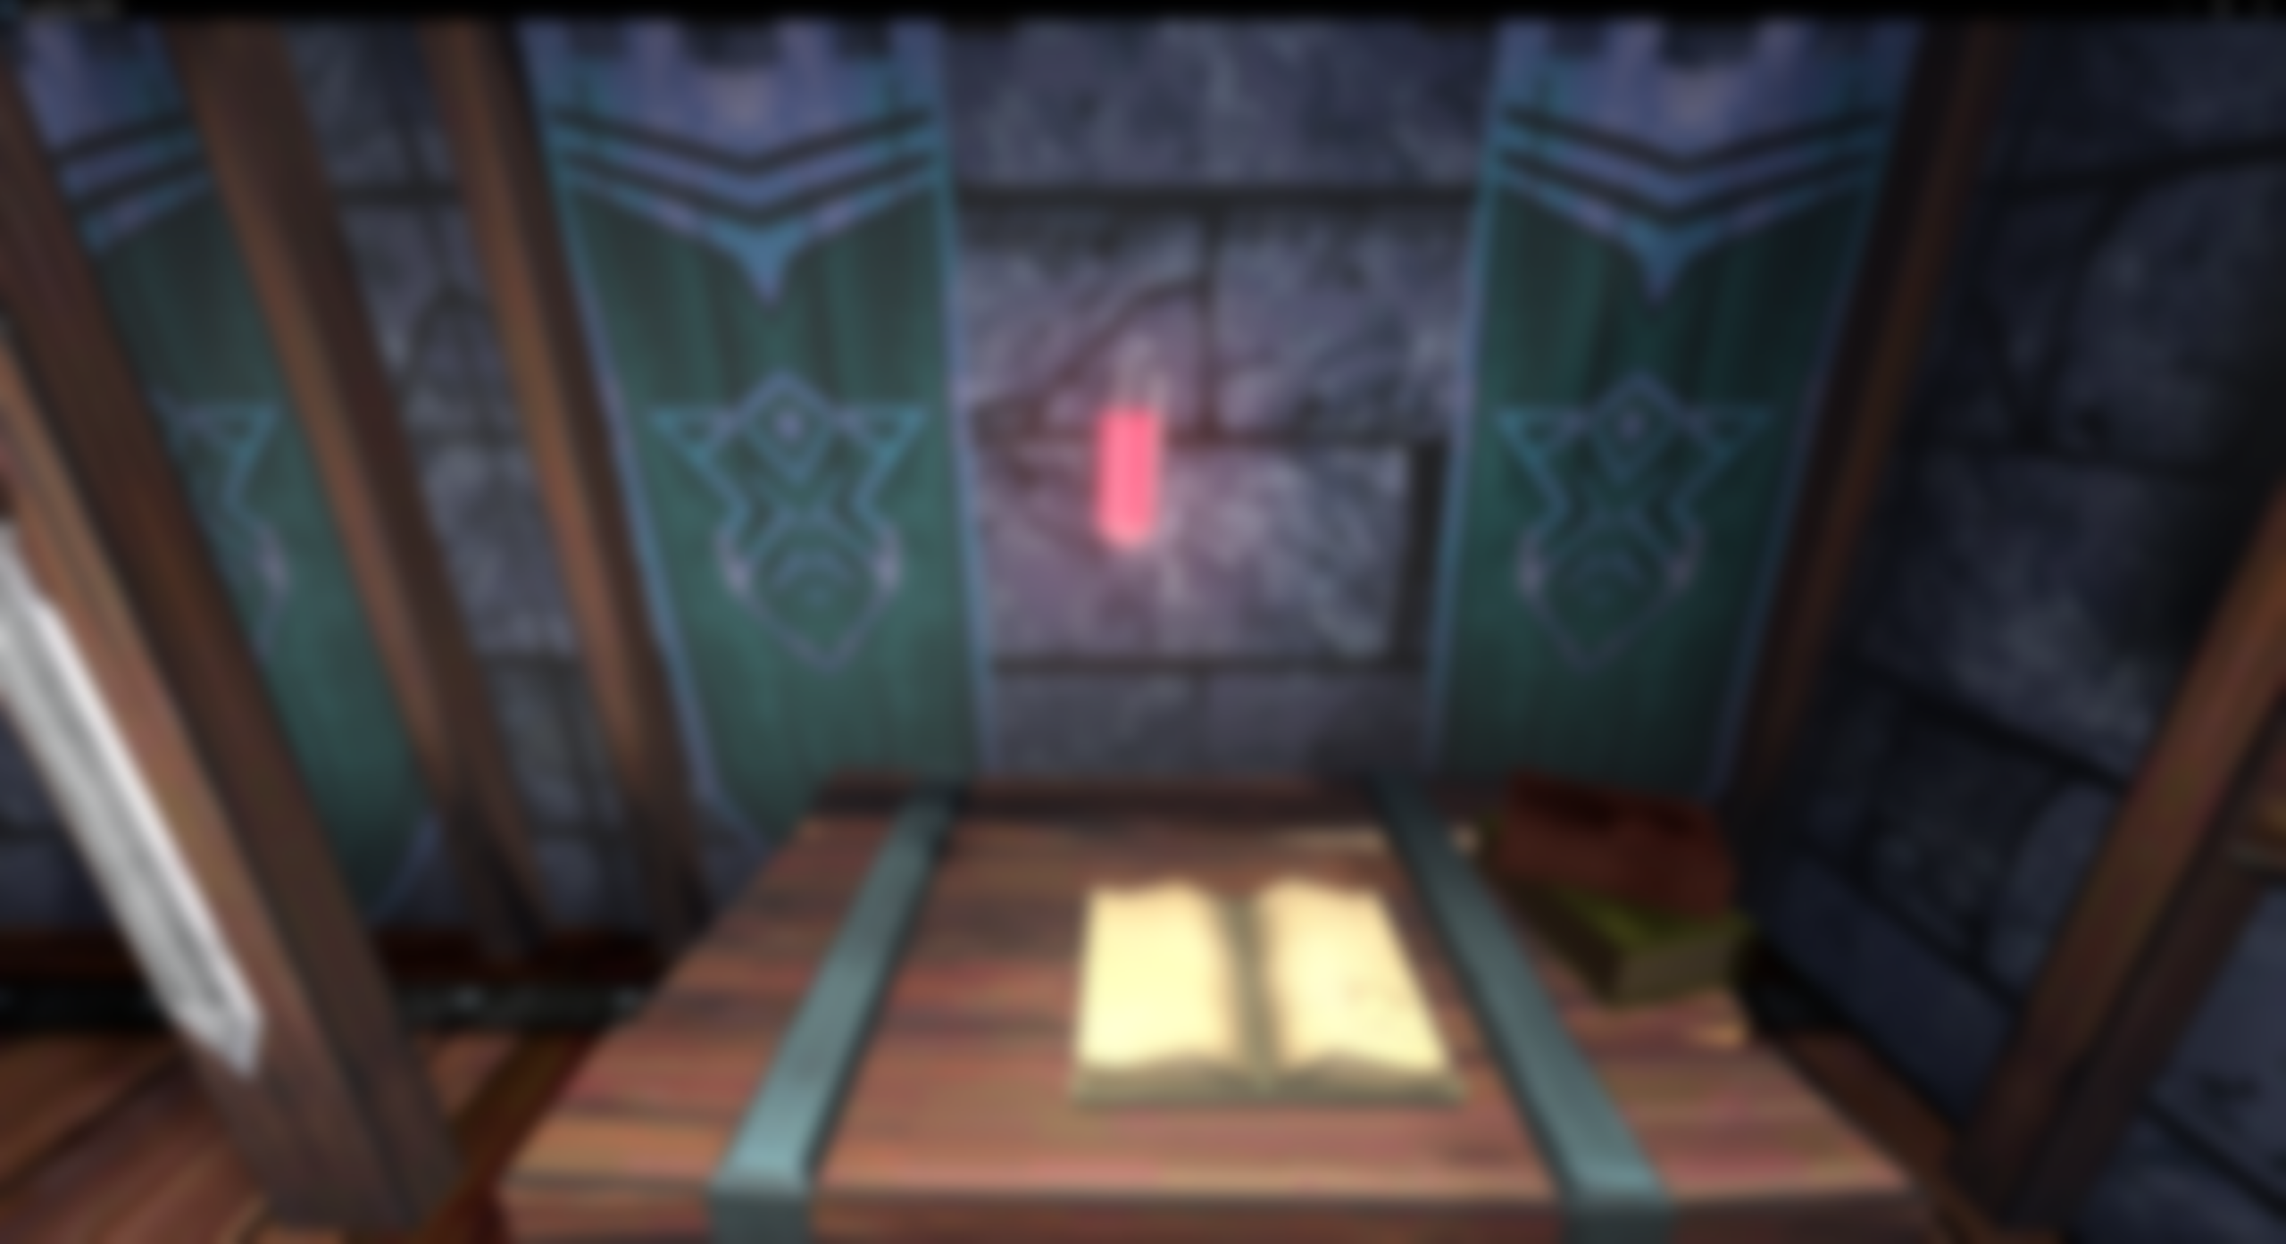
Liquid Bottle Shader in Godot 4
Lycia Stenson

Slide 2
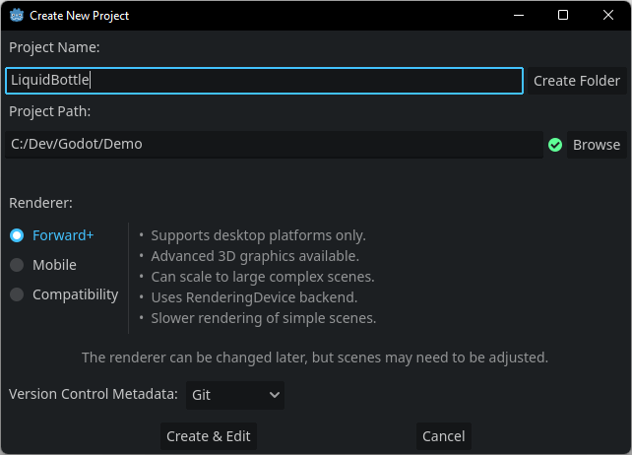
Creating a Project in Godot
Project Path - Navigate to the folder within which you will save your project
Create Folder will create a folder here with the name of your project

Slide 3
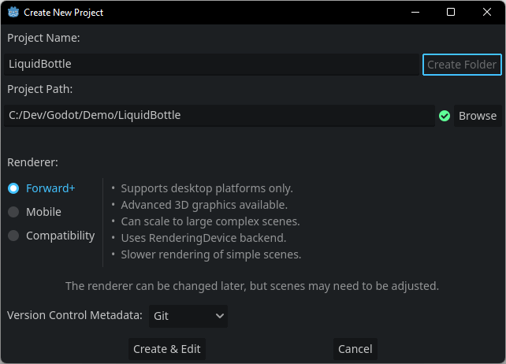
Creating a Project in Godot
Project Path - Navigate to the folder within which you will save your project
Create Folder will create a folder here with the name of your project

Slide 4
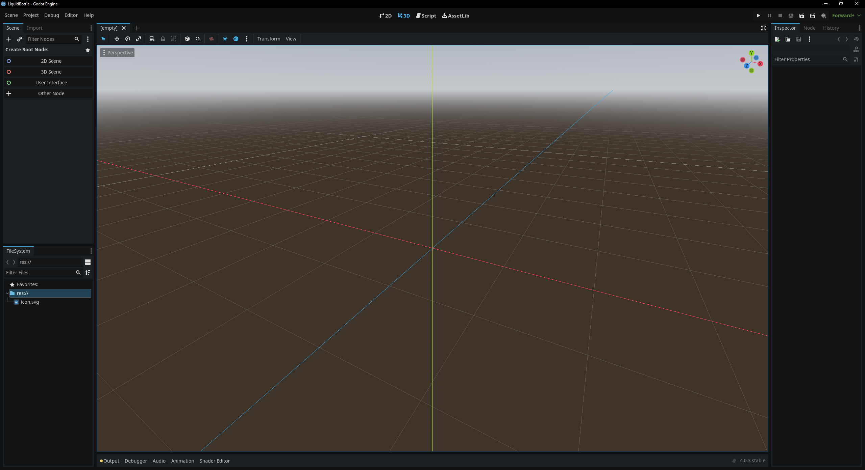

Slide 5
What you need to know about scenes in Godot
Unity has Scenes and Prefabs. Unreal has Scenes and Blueprint/C++ Classes.
However, Godot makes no distinction between scenes and objects. They are all Scene, made up of sub-objects called Nodes.
Levels, players, and other objects in Godot are all scenes
These can be saved as .tscn or .scn files (t refers to text, instead of binary) and placed within other scenes as part of the Node hierarchy.

Slide 6
Live Demo

